Slide 1



Grant Administration and Procurement
________________
National Association of Regional Councils
Presenter Name
Blake Ratcliff, Director
Institute for Building Technology and Safety

Slide 2

About EDDR
Risk
Challenges
Solutions
Questions?

Slide 3

What is a successful grant?
Grant Management is a system, a process with many levels.
You don’t have to be an expert, but you do have to know enough so that:
(A) you aren’t dangerous (B) you’re aware when you’re out of your depth.
Successful grant management starts long before the grant is awarded.
Successful Grants start with the End in Mind

Slide 4
Six Areas of Grant Management

Slide 5
Six Areas of Grant Management
Procurement
Financial
Building Department
Monitoring and Oversight
Special Requirements
Staffing

Slide 6
Six Areas of Grant Management
Financial
Procurement
Building Department
Monitoring and Oversight
Special Requirements
Staffing
Notes:
Challenges
-Procurement requirements may exceed current standards
-Existing procurement standards may require deviations to expedite program
-Procurement policies must be developed to support program goals
Solutions
-Review any specific procurement guidelines associated with grant and compare to existing procurement guidelines
-Often it is necessary to modify current procurement guidelines to accelerate grant program progress
-In consideration of the above create a “program” specific procurement policy
-Seek professional support to review procurement policy for compliance
-3rd Party QA/QC oversight is recommended

Slide 7
Six Areas of Grant Management
Building Department
Financial
Monitoring and Oversight
Special Requirements
Staffing
Notes:
Challenges
-Robust reporting requirements
-Knowledge of specific Federal/State requirements
-Specific training and software required to interact with Federal/state systems
Solutions
-Projects/Programs are eligible activities
-Documentation of all transactions is compliant and available
-Program compliance is understood and followed
-Reporting requirements and process are immediately instituted
-Augment staff with specialist familiar with Federal/State software systems
-3rd Party QA/QC oversight is recommended.

Slide 8
Six Areas of Grant Management
Monitoring and Oversight
Building Department
Special Requirements
Staffing
Notes:
Challenges
-Grant requirements may impose additional or updated codes or standards
-Plan Review or Field Inspection team may require augmentation
-Additional training and/or certifications may be required to ensure grant compliance
Solutions
-Update department standards to most recent code
-Anticipate department workload increase
-Provide training on code/ordnance revisions
-Augment department staff with trained professionals if necessary
-3rd party QA/QC oversight is recommended

Slide 9
Six Areas of Grant Management
Special Requirements
Monitoring and Oversight
Staffing
Notes:
Challenges
-Eligibility
-National Objective
-Identification/Compliance with Federal/State requirements
-Oversight and Quality Control Requirements
Solutions
-Determine if anticipated project/program expenditures are eligible costs within your grant program and document findings
-Ensure and document that National Objectives have been met
-Verify that no duplication of benefits/funds exist and document findings
-3rd party QA/QC oversight is recommended
-Augment staff with professionals if necessary

Slide 10
Six Areas of Grant Management
Special Requirements
Staffing
Notes:
Challenges
-City/County ordnances may require revision
-Special City Council or Commissioners Court meetings may be required
Solutions
-Anticipate the need to adjust existing planning & zoning requirements to facilitate program.
-Be prepared for special sessions or emergency meetings to quickly resole or approve issues

Slide 11
Six Areas of Grant Management
Staffing
Notes:
Challenges
-Staff is committed to other projects
-Technical requirements
-Temporary staff requires training
-Temporary staff requires additional management support
-Additional staff with very specific expertise may be required
Solutions
-Evaluate potential staffing requirements prior to grant award
-Don’t hesitate to solicit support from professional consultants
-Consider procuring a program administrator for efficient and compliant implementation of your grant program

Slide 12
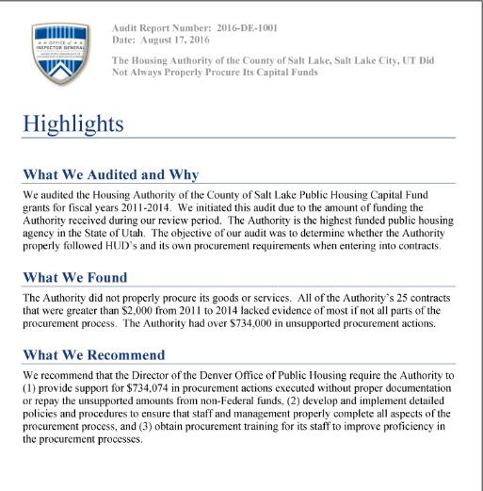
The 2 priority Areas
Procurement
Monitoring & Compliance

Slide 13
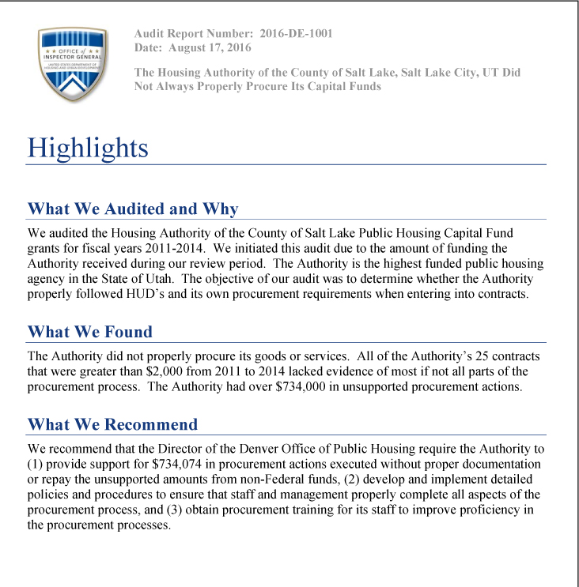
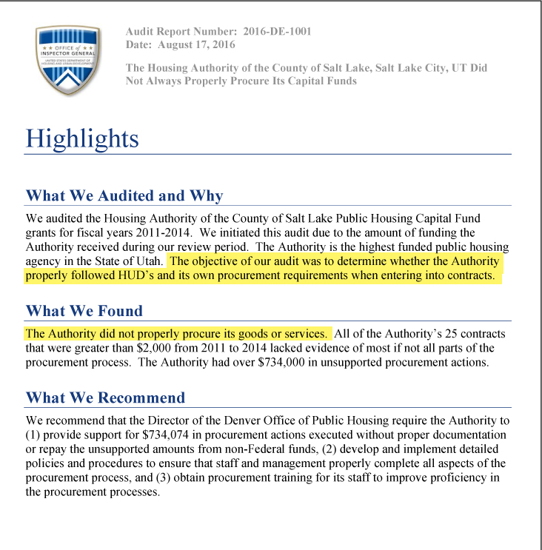
Procurement
Largest of IG findings are related to Procurement issues

Slide 14

Procurement
Largest of IG findings are related to Procurement issues
Common actions taken by IG
  Provide Documentation
  Repayment
  Develop policy & procedure
  Training

Slide 15
Procurement
Understanding CDBG Procurement – 2 CFR Ch. II (1-1-14) Edition
  200.317 – Procurements by states
  200.318 – General Procurement standards
  200.319 – Competition
  200.320 – Methods of procurement to be followed
  200.321 – Contracting with small and minority business, women’s business enterprises, and labor surplus area firms
  200.322 – Procurement of recovered materials
  200.323 – Contract cost and price
  200.324 – Federal awarding agency or pass-through entity review
  200.325 – Bonding Requirements
  200.326 – Contract Provisions
  200.338 – Remedies for noncompliance

Slide 16
Procurement
Understanding CDBG Procurement – 2 CFR Ch. II (1-1-14) Edition
  200.317 – Procurements by states
  200.318 – General Procurement standards
  200.319 – Competition
  200.320 – Methods of procurement to be followed
  200.321 – Contracting with small and minority business, women’s business enterprises, and labor surplus area firms
  200.322 – Procurement of recovered materials
  200.323 – Contract cost and price
  200.324 – Federal awarding agency or pass-through entity review
  200.325 – Bonding Requirements
  200.326 – Contract Provisions
  200.338 – Remedies for noncompliance
  200.403 – Factors affecting allowable cost
  200.403 (a) – Be necessary and reasonable for the performance of the Federal award and be allocable thereto under these principles.
  200.403 (g) – Be adequately documented.

Slide 17

Procurement
Understanding CDBG Procurement – 2 CFR Ch. II (1-1-14) Edition
  200.338 – Remedies for noncompliance
  200.403 – Factors affecting allowable cost
  200.403 (a) – Be necessary and reasonable for the performance of the Federal award and be allocable thereto under these principles.
  200.403 (g) – Be adequately documented.
  Must have written procurement procedures
  Must maintain records of history of procurement

Slide 18
Types of Procurement
Sealed (formal) Bids – 2 CFR 200.320
Informal Bids – 2 CFR 200.320
A&E Procurement – 2 CFR 200.321
Notes:
200.320
In order for sealed bidding to be feasible, the following conditions should be present
A complete, adequate, and realistic specification or purchase description is available
Two or more responsible bidders are willing and able to compete effectively for the business
The procurement lends itself to a firm fixed price contract and the selection of the successful bidder can be made principally on the basis of price

Slide 19
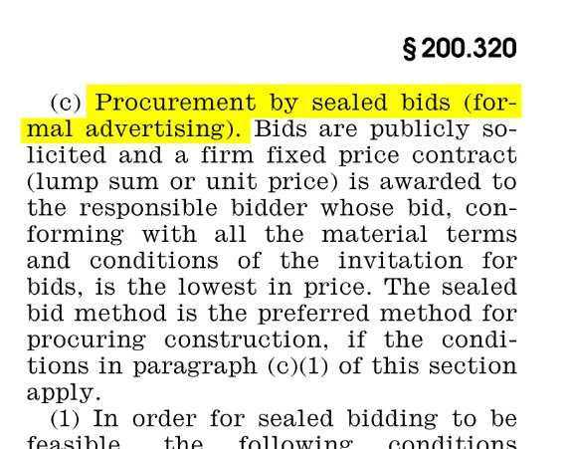
Types of Procurement
Sealed (formal) Bids – 2 CFR 200.320
Informal Bids – 2 CFR 200.320
A&E Procurement – 2 CFR 200.321
Notes:
200.320
In order for sealed bidding to be feasible, the following conditions should be present
A complete, adequate, and realistic specification or purchase description is available
Two or more responsible bidders are willing and able to compete effectively for the business
The procurement lends itself to a firm fixed price contract and the selection of the successful bidder can be made principally on the basis of price

Slide 20
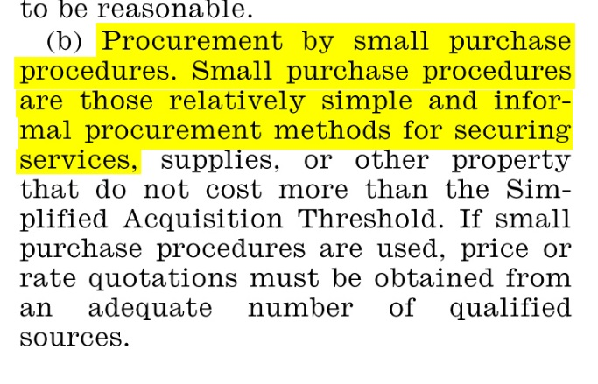
Types of Procurement
Sealed (formal) Bids – 2 CFR 200.320
Informal Bids – 2 CFR 200.320
A&E Procurement – 2 CFR 200.321
Notes:
200.320
If small purchase procedures are used, price or rate quotations must be obtained from an adequate number of qualified sources

Slide 21
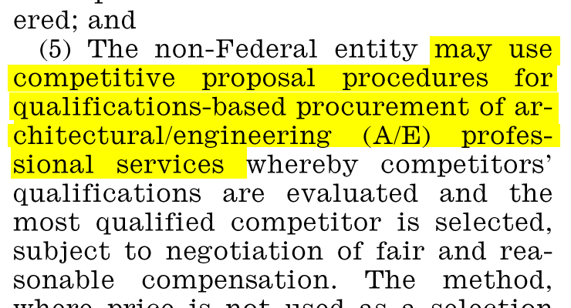
Types of Procurement
Sealed (formal) Bids – 2 CFR 200.320
Informal Bids – 2 CFR 200.320
A&E Procurement – 2 CFR 200.321
Notes:
200.321
(5) The method where price is not used as a selection factor, can only be used in procurement of A&E professionals services. It cannot be used to purchase other type of services though an A&E firms are a potential source to perform the proposed effort.

Slide 22
Questions?

Slide 23
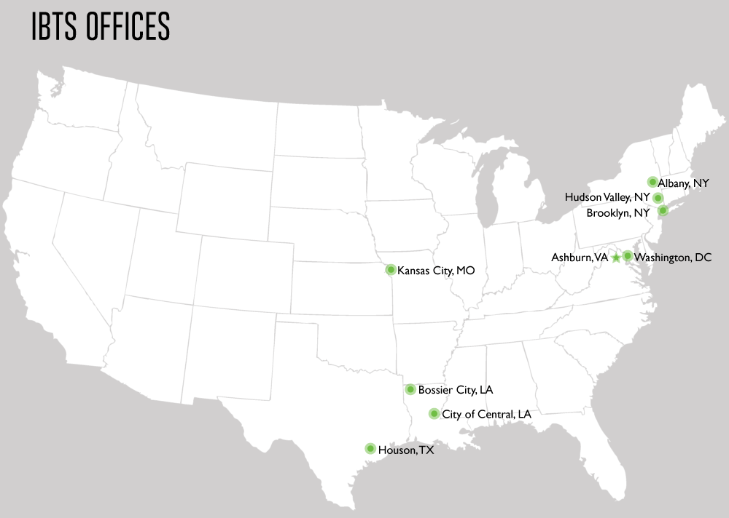

Blake Ratcliff
45207 Research Place
Ashburn VA, 20147

